Slide 1

Long-term Trend on Tumour Thickness of Melanoma in Norway
Faculty of Medicine
NOFE Conference 2021
Raju Rimal
Post-doctoral researcher
Oslo Centre for Biostatistics and Epidemiology
Notes:
Hello! I am Raju. Currently working on the project «Prognosis factor of Melanoma in Norway» funded by research council of Norway.
Before starting the presentation, I would like to talk a little on the background.

Slide 2
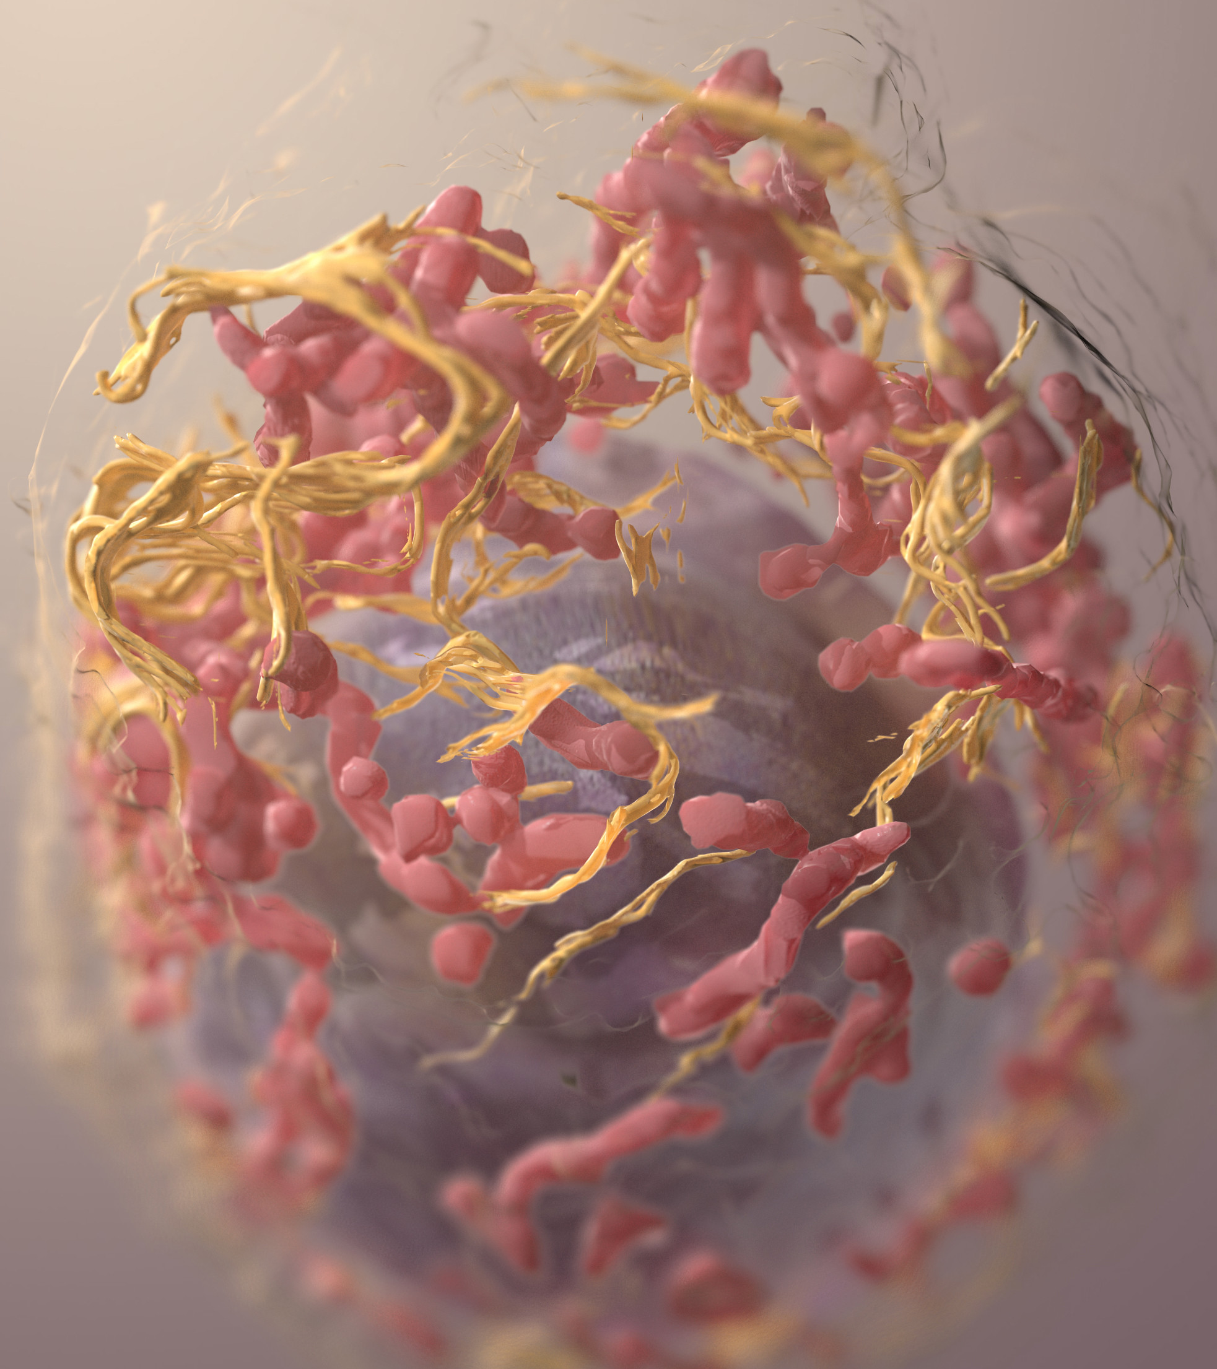
Melanoma
Serious form of skin cancer
Pigmentation and UV radiation exposure are the most important risk factors.
It can be cured if caught and treated early but if left untreated, it may spread to other parts and can be fatal.
Melanoma has increased dramatically in fair skinned population worldwide.

Slide 3
Norway is
5th in incidence
and
2nd in mortality
worldwide
Notes:
In this study, we like to investigates a long-term trend on tumour thickness, cancer incidence and mortality corresponding to T-categories, both overall and in important subgroups such as sex, age, anatomic sites.
This study incorporates nation wide cases series over 40 year of period.
So, lets talk a little about the tumour, how they are used to staging the cancer.

Slide 4
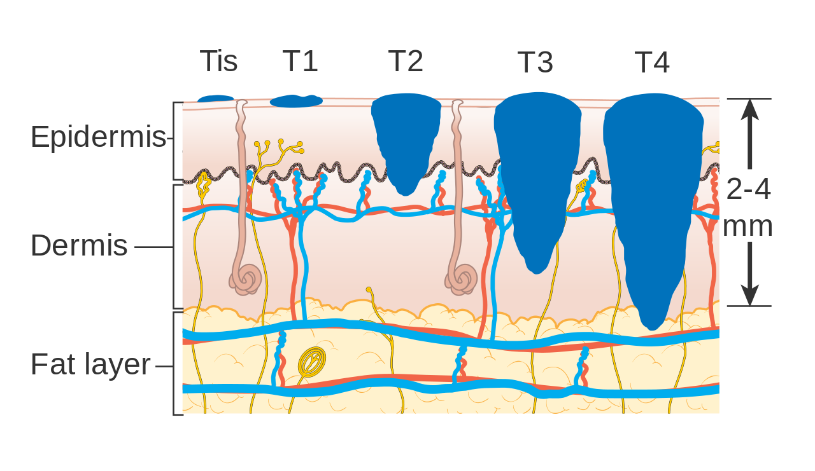
Tumour thickness
The most important prognostic factor
T category
(Tis) | In situ
T1 | up to 1mm
T2 | from 1mm up to 2mm
T3 | from 2mm up to 4mm
T4 | more than 4mm
Source: Cancer Research UK / Wikimedia Commons

Slide 5
To study long-term trends in melanoma tumour thickness, overall and in important subgroups such as sex, age and anatomic sites, in a unique nationwide case series over a 40-year time period.
Aim of the Study
Notes:
In this study, we like to investigates a long-term trend on tumour thickness, cancer incidence and mortality corresponding to T-categories, both overall and in important subgroups such as sex, age, anatomic sites.
This study incorporates nation wide cases series over 40 year of period.
So, lets talk a little about the tumour, how they are used to staging the cancer.

Slide 6
Melanoma in Norway
1953
1980
2000
2008
2019
Melanoma Registration Started
Start of our study
Data on tumour thickness
Less missing
Melanoma Registry
Even less missing
End of our study
Melanoma registry was established.
For this project, data were digitized from the paper archives
From 2000, more information are registered and data have less missing.
We included all Norwegian melanoma cases with tumour thickness from 1980 to 2019.
Notes:
Here is a timeline where Norway has started collected data on Melanoma.
We have data on melanoma since 1953 which might be one of the longest time series data on melanoma in the world.
Since 1980, CRN also started to collect data on tumour thickness, however those were on the paper archives which we have recently digitized.
Until 2000, data on ulceration of tumour were not in good quality.
However, in 2008, after Melanoma registry was established we have high quality data on different variables on melanoma.
These are some background, I like to dive into the aim of this study.

Slide 7
Characteristics of Norwegian melanoma cases
Characteristic¹ | Overall N = 47,438 | Women N = 24,522 (52%) | Men N = 22,916 (48%)
Age, median (IQR) | 62 (49 – 74) | 60 (46 – 73) | 64 (52 – 74)
Thickness, median (IQR) | 1.00 (0.60 – 2.20) | 1.00 (0.60 – 2.00) | 1.20 (0.70 – 2.50)
Unknown | 7,665 | 3,925 | 3,740
¹ Median (IQR)
Characteristic¹ | Overall N = 47,438 | 1980-1999 N = 15,919 (34%) | 2000-2007 N = 8,780 (18%) | 2008-2019 N = 22,739 (48%)
Age, median (IQR) | 62 (49 – 74) | 58 (44 – 71) | 62 (49 – 75) | 65 (53 – 75)
Thickness, median (IQR) | 1.00 (0.60 – 2.20) | 1.15 (0.70 – 2.50) | 1.10 (0.69 – 2.44) | 1.00 (0.60 – 2.00)
Unknown | 7,665 | 4,674 | 1,218 | 1,773
¹ Median (IQR)
Notes:
Here is some univariate summaries of different variables by Sex in different periods over the years.
We can see the median age at diagnosis has increased from 56 to 63 in women and 59 to 67 in men from the period 1980-1999 to 2008-2019.
Men were diagnosed in later age than women the age at which they were diagnosed has been increased in the recent years.
Age group 40-84 covers more than 70% of the cases. We see that in women aged 60-84 the proportion has raised from 40 to 47 and in men this proportion raised from 46 to 60.
Most cases are in Trunk for men and both trunk and lower limbs is common in women.
The median tumour thickness has decreased over the years in both men and women.
T1 is the most common cases in all period and has increased over the time.
Let us look as some of these proportion by T-stages.

Slide 8

Age-adjusted Incidence Rate
Age standardized incidence rate (ASIR) increased in T categories.
T1 has the highest ASIR.
Between1996 and 2006, a plateau is visible in T1 in both sexes.
Incidence of cases with T1 tumour is large compared with others
Notes:
These two plots has same underlying data

Slide 9
Age-adjusted Incidence Rate
Incidence of T1 is higher in women than men.
Incidence of T3 and T4 are higher in men than women.
The difference between men and women in T3 and T4 have become larger over the years.
Notes:
These two plots has same underlying data

Slide 10


Age-adjusted Incidence Rate
By sex, anatomic site and T category
In men, trunk has the highest incidence.
In women, both trunk and lower-limbs have the highest incidence.
Head and neck has lower incidence compared to the other sites but incidence is increasing in all T categories.
T1 and T2 cases have increasing trend in all sites.
T3 varies between sites, while T4 is more stable or increasing.
Notes:
These two plots has same underlying data

Slide 11
Age adjusted Incidence Rate
By sex, histopathological subtype and T category
Superficial Spreading Melanoma (SSM) has highest ASIR than Nodular Melanoma (NM).
T1 cases are common in SSM and has high and increasing trend.
Thicker cases (T3 and T4) are observed mostly in NM. T4 has increasing trend in the recent years.
Plateau observed in T1 is found in SSM cases but the plateau has steady increase after its start.
In NM, a plateau in ASIR is observed in T3 and T4 but in a different period than the overall plateau.
Huge difference in the incidence
In T1 compared to other
Notes:
These two plots has same underlying data

Slide 12
Age-Period-Cohort plot
Age at diagnosis
In total, incidence increases over age in all birth cohorts. Older age groups have a clear cohort effect.
T1 shows a similar trend as the total. Less clear cohort effect in thicker cases (T3 and T4).

Slide 13
Preliminary Conclusion
T1 (thin) melanomas have the highest incidence among all T categories and also have a clear increasing trend. | Awareness has likely contributed to the rapid rise in melanoma incidence.
Although the incidence in T1 is higher than the other, the incidence in thicker melanomas is also increasing. | Over-diagnosis is important to consider, but cannot explain the increase in thicker melanomas.
For the thicker cases, the difference in incidence between men and women has become larger. | Awareness focused on elderly males would be effective for early detection.

Slide 14



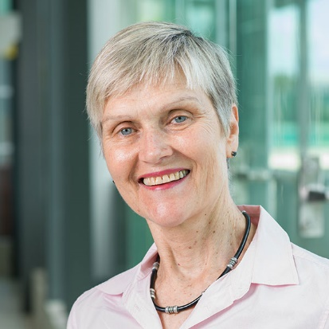

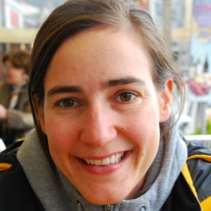


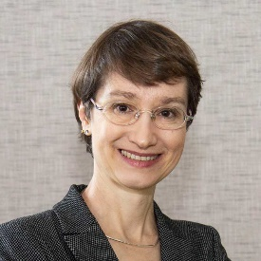


Acknowledgement
The project is funded by
Collaborating Institutes
Raju Rimal
Trude E Robsahm
Adele Green
Reza Ghiasvand
Oslo Centre for Biostatistics and Epidemiology (OCBE)
Corina S Rueegg
Assia Bassarova
Petter Gjersvik
Elisabete Weiderpass
Odd O Aalen
Bjørn Møller
Harald W- Fekjaer
Marit B. Veierød

Slide 15


Slide 16
References
L. X. Clegg, B. F. Hankey, R. Tiwari, et al. "Estimating Average Annual per Cent Change in Trend Analysis". In: Statistics in medicine 28.29 (Dec. 2009), pp. 3670-3682. ISSN: 0277-6715. DOI: 10.1002/sim.3733.
V. M. Muggeo. "Interval Estimation for the Breakpoint in Segmented Regression: A Smoothed Score-Based Approach." In: Australian & New Zealand Journal of Statistics 59 (2017), pp. 311-322. DOI: https://doi-org.ezproxy.uio.no/10.1111/anzs.12200.
V. M. Muggeo. "Segmented: An r Package to Fit Regression Models with Broken-Line Relationships." In: R News 8.1 (2008), pp. 20-25.
S. N. Wood. "Partially Specified Ecological Models". En. In: Ecological Monographs 71.1 (2001), pp. 1-25. ISSN: 1557-7015. DOI: 10.1890/0012-9615(2001)071[0001:PSEM]2.0.CO;2.
Baade, Peter D., David C. Whiteman, Monika Janda, Anne E. Cust, Rachel E. Neale, Bernard Mark Smithers, Adele C. Green, et al. “Long‐term Deaths from Melanoma According to Tumor Thickness at Diagnosis.” International Journal of Cancer, 2020. https://doi.org/10.1002/ijc.32930.
Baade, Peter, Xingqiong Meng, Danny Youlden, Joanne Aitken, and Philippa Youl. “Time Trends and Latitudinal Differences in Melanoma Thickness Distribution in Australia, 1990–2006.” International Journal of Cancer 130, no. 1 (2012): 170–78. https://doi.org/10.1002/ijc.25996.
Cancer Registry of Norway. “Cancer in Norway 2019: Cancer Incidence, Mortality, Survival and Prevalence in Norway.” Cancer Registry of Norway, 2020. https://www.kreftregisteret.no/globalassets/cancer-in-norway/2019/cin_report.pdf.
Erdmann, Friederike, Joannie Lortet-Tieulent, Joachim Schüz, Hajo Zeeb, Rüdiger Greinert, Eckhard W. Breitbart, and Freddie Bray. “International Trends in the Incidence of Malignant Melanoma 1953-2008-Are Recent Generations at Higher or Lower Risk?” International Journal of Cancer 132, no. 2 (2013): 385–400. https://doi.org/10.1002/ijc.27616.

Slide 17
References
Ferlay, J., M. Ervik, F. Lam, and et al. “Global Cancer Observatory: Cancer Today,” 2018.
Garbe, C., U. Keim, T. K. Eigentler, T. Amaral, A. Katalinic, B. Holleczek, P. Martus, and U. Leiter. “Time Trends in Incidence and Mortality of Cutaneous Melanoma in Germany.” Journal of the European Academy of Dermatology and Venereology 33, no. 7 (July 1, 2019): 1272–80. https://doi.org/10.1111/jdv.15322.
Gershenwald, J. E., R. A. Scolyer, K. R. Hess, J. F. Thompson, G. V. Long, M. I. Ross, A. J. Lazar, and M. B. Atkins. “Melanoma of the Skin.” In AJCC Cancer Staging Manual, edited by Amin MB, 8th ed., 563–85. Chicago: Springer, 2017.
Kreftregisteret,. “Årsrapport 2019 Med Resultater Og Forbedringstiltak Fra Nasjonalt Kvalitetsregister for Melanom.” Oslo: Kreftregisteret, 2020.
Kruijff, S., E. Bastiaannet, A. B. Francken, M. Schaapveld, M. van der Aa, and H. J. Hoekstra. “Breslow Thickness in the Netherlands: A Population-Based Study of 40 880 Patients Comparing Young and Elderly Patients.” British Journal of Cancer 107, no. 3 (2012): 570–74. https://doi.org/10.1038/bjc.2012.255.
Robsahm, T. E., P. Helsing, Y. Nilssen, L. Vos, S. M. H. Rizvi, L. A. Akslen, and M. B. Veierod. “High Mortality Due to Cutaneous Melanoma in Norway: A Study of Prognostic Factors in a Nationwide Cancer Registry.” Clin Epidemiol 10 (2018): 537–48. https://doi.org/10.2147/clep.S151246.
Robsahm, Trude E., Gjøril Bergva, Unn E. Hestvik, and Bjørn Møller. “Sex Differences in Rising Trends of Cutaneous Malignant Melanoma in Norway, 1954-2008.” Melanoma Research 23, no. 1 (February 2013): 70–78. https://doi.org/t.
Whiteman, David C., Adele C. Green, and Catherine M. Olsen. “The Growing Burden of Invasive Melanoma: Projections of Incidence Rates and Numbers of New Cases in Six Susceptible Populations through 2031.” The Journal of Investigative Dermatology 136, no. 6 (2016): 1161–71. https://doi.org/10.1016/j.jid.2016.01.035.

